Slide 1



CONSULTARE INC. GROUP
A Compliance Co.
Texas-based with International Operations in Asia, Latin America, North America, Europe, and Africa
Specializes in regulatory, accreditation, certification, quality management system software, and IT solution consultancy
Established 2013

Slide 2
CERTIFICATION, ACCREDITATION, AND REGULATORY SERVICES
FDA, USDA, OSHA, FSMA, HACCP, GMPs, FSVP
Halal, Organic, Kosher, Non-GMO, Gluten-free, Vegan
GFSI - SQF, BRCGS, ISO (FSSC 22000), PrimusGFS, IFS
Big-box Retailers (Amazon, Walmart, Costco, etc.)
USDA Grant Writing and Application Services
Management System Development, Implementation, and Maintenance
Mitigation Plans (Crisis Management, Food Defense, Food Fraud)]
HACCP/Food Safety Plans
Withdrawal and Recall Plans
Gap Analysis, Risk Assessments, and Internal Audits
Importing/Exporting Compliance
Product Marketing Compliance (Label, Packaging, and Web Content Regulatory Review)

Slide 3
EXECUTIVE REMOTE SERVICES
Accounting Services
Accreditation Management
Advertising Management
Amazon Store Management
Auditing
Allergen Management Program Writing Services
Allergen Management Program Consulting Services
Back Office Support
Bookkeeping
BRCGS
Business Plan Development
CAPA Management
Cannabis Cultivation Guidance Bundle Services
Cannabis Manufacturing Guidance Bundle Services
Cannabis Retail Guidance Bundle Services
Cannabis Consulting Services
Certification Management
Collection Services
Complaint Management
Compliance Management
Contract Management
Cosmetic Compliance
Crisis Management
Customer Requirements Review
Customer Services
Data Entry & Analytics
Deep Dive Remote Gap Audit (Certification, Regulatory, Accreditation)
Document Control Management
Document Review
E-commerce Store Set-up (Amazon/Shopify/Wordpress)
E-commerce store management
E-Forms Digitization (Software Development)
Executive Assistant
Feasibility Study
Food Fraud Vulnerability Assessments Services
Foreign Supplier Verification

Slide 4
EXECUTIVE REMOTE SERVICES
Food Safety Consulting Overview
Food Safety Compliance Management
FSVP Services
FSVPQI Services
FSQA Services
Food Safety Plan Services
FSSC 22000
FDA (USA) = FSMA Preventive Control Plans
General Administration
Grant Writing and Submission Services
Good Manufacturing Practices Consulting
Graphic Designs
HACCP Plan Services
HR and Training Management
Import & Export Compliance Services
Internal Audit Management
Inventory Control Management
ISO Standards
IT Development & Services
Marketing Material Review
Marketing Services
On-Site Consultancy Services – Preventive and Process Controls, and Internal Audit
OSHA Services
CalOSHA Services
PCQI Consulting Services - Preventive Controls Qualified Individual
Pharmaceutical Compliance
Preventive Maintenance
Project Management
Product Research
Product Label Regulatory Review for Food - US
Product Label Regulatory Review for Food - Australia New Zealand Food Standards Code
Product Label Regulatory Review for Food - CFIA (Canada)
Product Label Regulatory Review for Dietary Supplement - US

Slide 5
EXECUTIVE REMOTE SERVICES
Product Label Regulatory Review for Cosmetics - US
Product Label Regulatory Review for Cosmetics - EU
Product Label Regulatory Review for Animal Food - US
Quality Assurance Systems
Quality Control Systems
QMS Management
Recruiting Services
Regulatory Compliance Review
Regulatory Response Letter Development
Research
Sanitation Management
SFCR (Canada) Preventive Control Plans
Supplier Approval Programs
SOPs and SSOPs Writing Services
Supply Chain Management
SQF Food Manufacturing Bundle Writing Services
SQF Manufacture of Food Packaging Bundle Writing Services
SQF Storage and Distribution Bundle Writing Services
SQF Dietary Supplement Manufacturing Bundle Writing Services
SQF Certification Consulting Services
SQF Certification and Gap Assessment Services
System Algorithm (Software Development)
Technical SOP and Forms for Records Development
Traceability and Recall Management
Virtual Executive Assistant
Virtual Executive QA/QC Services
Web Designer
Website Content Review

Slide 6

Consultare Inc Group
The goal of Consultare Inc Group company orientation is to help new employees familiarize themselves with organization's culture, policies, procedures, and expectations.
CONSULTARE INC. GROUP
A Compliance Co.

Slide 7
On behalf of the entire Consultare team, I am delighted to extend a warm welcome to you as our newest member! We are thrilled to have you on board and look forward to the positive contributions we know you will make to our team.
Starting a new journey with a company is an exciting and significant moment, and we are here to support you every step of the way. At Conultare Inc Group, we value innovation, collaboration, and a commitment to excellence. We believe that our collective efforts contribute to the success of our organization and create a positive and dynamic work environment.
As you embark on your new role, you'll find a team dedicated to achieving our shared goals. Whether you are inquiring, learning, or contributing your unique skills, your presence adds tremendous value to our workplace.
Please feel free to reach out to if you have any questions or if there's anything you need assistance with.
Once again, welcome to the Consutare family! We are excited to have you with us and look forward to achieving great things together.
Best regards,
Arnel Ryan
CEO, Consultare Inc Group
WELCOME
AND
INTRODUCTION

Slide 8
CONSULTARE INC GROUP HISTORY, MISSION, AND VALUES.
OUR COMPANY
Consultare Inc. Group provides regulatory compliance and consulting services to manufacturers, distributors, and importers of foods, beverages, dietary supplements, drugs, cosmetics, medical devices, or electronic products.
We contribute to a company’s growing Regulatory and Certification Compliance, Food Safety Management System, Quality System, Quality Management System, and HACCP development, implementation, maintenance, and monitoring on a full-time consultancy position.

Slide 9




OUR HISTORY
Consultare Inc. Group was started as Nutripro LLC in December of 2013.
In December 2017, our name was changed to Consultare Inc. The name Consultare came from the Spanish word “Consultare” in English “ I will consult”.
In January of 2023, the company was formally changed to Consultare Inc Group.

Slide 10
OUR MISSION
Consultare Inc Group is committed in providing expertise, guidance, and solutions to make sure that organizations will operate within the bounds of applicable laws, regulations, and ethical standards. We are committed in helping clients the complex landscape of ethical consideration and regulations that will contribute to the integrity, sustainability, and the success of their business.

Slide 11
OUR VALUES
I Integrity and Innovation
C Compliance Excellence
A Accountability
R Respect and Responsibility
E Education and Empowerment

Slide 12
INTEGRITY AND INNOVATION
Adherence to ethical principles, honesty, fairness, dedication and commitment, selflessness. It's doing the right thing all the time, every time.
Implementation of new idea approaches to compliance challenges and to seek a solution to meet evolving regulatory requirements.

Slide 13
COMPLIANCE EXCELLENCE
A priority to support the quality, safety, environmental, security and regulatory objectives of a company. This involves the application of continuous improvement, the elimination of waste and variability, and most importantly the reduction of risk.

Slide 14
ACCOUNTABILITY
Holding oneself and others accountable for the compliance effort and taking responsibility for the actions and decisions.

Slide 15
RESPECT AND RESPONSIBILITY
We aim for the company and organization to operate in full compliance with legal regulations and industry-specific guidelines. We monitor the internal policies and bylaws. In the event of regulatory risks or misconduct, we aim to address concerns and find solutions to these challenges.
Respecting the rights and interest of all members and collaborators. As well as building and maintaining a positive relationship with the clients, regulatory body, and the community.

Slide 16
EDUCATION AND EMPOWERMENT
Empowering our Team and clients through education on compliance and regulatory matters and by facilitating a culture of accountability, awareness, and knowledge.

Slide 17

“Where process meets industry connectivity”
Developed for “You”, the owner, entrepreneur, operator, the agent in charge of a facility or process, the practitioner

Slide 18
Compliance Dashboard Module
HR Management Module
Facility Management Module
Supplier Management Module
Customer Management Module
Products/Services Directory Module
Enterprise Module
Job Ticket Module
Library Module
Archive Module
Crisis Management Module
Meeting Minutes Module
Records Verification Management Module
Food Fraud Vulnerability Assessment
(FFVA) Management Module
Internal Audit (IA) Management Module
MyPro Management Module
Preventive Maintenance Program (PMP) Management Module.
Notes:
Total Modules - 17

Slide 19

Unlimited system users (except for MyPro Management Module) – Customer, Supplier, and Employees Coaching, Navigation and Mentorship - Developed by IT Blaster
Corrective Action Preventive Action Management (CAPAM) Module
CRM - Customer Relationship Management Module
Environmental/Pathogen Monitoring Management
Sanitation Management Module
Inventory Management Module
Formula / Recipe Management Module

Slide 20
Provides end-to-end managed services that meets your expectations and deliverables

Slide 21
IT BLASTER
Application Development
Cybersecurity Support Services
Database Management
Data Protection & Strategy
E-Commerce Development & Maintenance (Shopify, etc.)
Infrastructure Development & Development
Internet of Things
IT Architecture
IT Help Desk Support
IT Maintenance & Support
IT Project Management
IT Staff Support
IT System Engineering Software Development
IT Technical Support
SEO Management
Website Development & Deployment

Slide 22

One Stop SOP Templates Shop
Programs, Policies, SOPs, Forms, and Training Materials Customizable Templates

Slide 23
CONSULTARE INC GROUP COMPLIANCE SERVICES
Set-Up
Where we cover the complete set-up of your programs, policies, procedures, forms for record, and training material requirements development and customization for use in complying with the Compliance, Certification, and Regulatory Requirements.
SOPKing.com
Provides D-I-Y (Do It Yourself) templates for any process through Accreditation, Certification, and Regulatory Requirements.
Software
InterlinkIQ connects technologies and services that enable enterprises and users to interlink their activities and processes such as: Customer & Supplier Requirements, Document Sharing, Inventory Management, Production Planning, Product Release, Formulation, Master Manufacturing Records, Traceability, Employees Assigned Duties, QC Forms, SOPs, Training Materials, and System Software.
Services (End-to-End/ Support)
Covers engagement on a monthly basis and is designed to provide full and support assistance in complying with Regulatory, Accreditation, and Certification requirements.

Slide 24
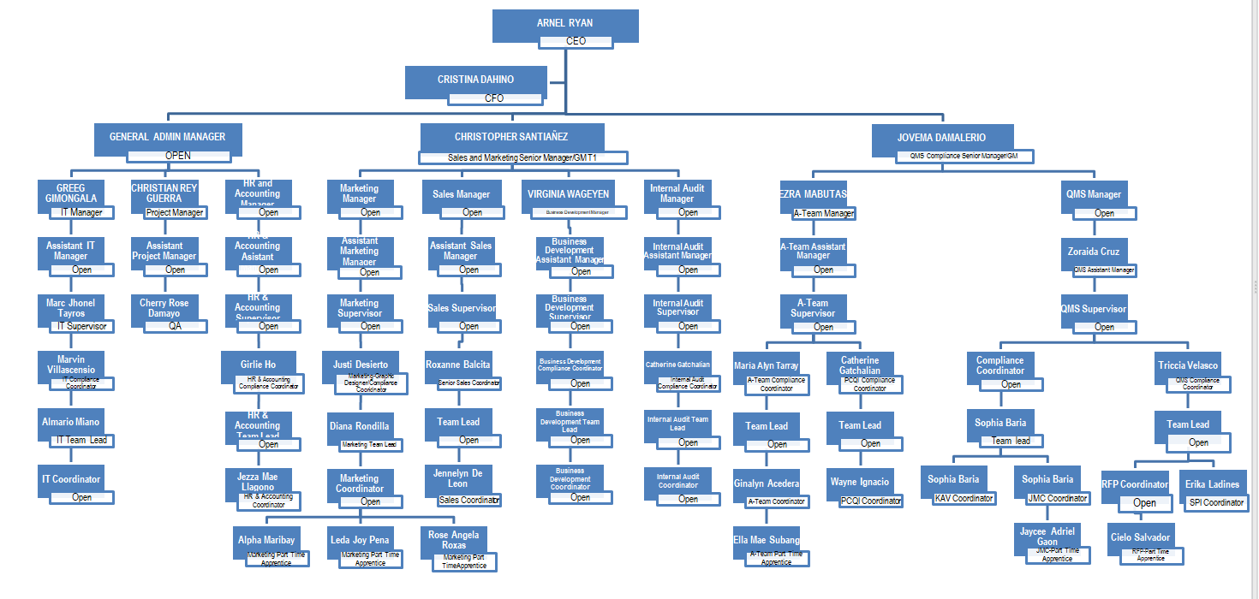
OUR TEAM
CONSULTARE INC. GROUP

Slide 25

WORK SCHEDULE
Monday to Friday
11:00 PM to 7:00 AM PhT
9:00 AM to 5:00 PM CST Time
LEAVE AND BENEFITS
24 days Paid Time Off
1 week Paternity Leave
6 weeks Maternity Leave
6 US Holidays (Memorial Day, Independence Day, Labor Day, Thanksgiving, Christmas and New Years Day)

Slide 26
VIRTUAL ASSISTANT EMPLOYMENT STATUS
Full-time Virtual Assistants - perform at least 8 hours per day or 40 hours per week, Monday to Friday.
Part-Time Virtual Assistant - perform at least 4-6 hours a day or 20- 30 hours per week, Monday to Friday.
Part-Time Apprentice – a working student to perform 20 to 30 hours a week assigned to a specific department.
Part-time project-based – a specialist to perform 20 to 30 hours a week, Monday to Friday.

Slide 27
VIRTUAL ASSISTANT EMPLOYMENT STATUS
Freelancer - performs and completes the task/project:
IT Freelancers – perform tasks based on per Project and is evaluated by the Project Manager and approved by the IT Manager.
Freelance Writer – QMS – per SSOP Project for Program Form Lesson Bundle can be a Document/Project/Task and is reviewed and approved by the QMS/Compliance Manager.
Freelance Video Editor – perform tasks based on per Video and is reviewed and approved by the Marketing/Business Development Manager.

Slide 28
INTERNAL TRAINING
Full-time Virtual Assistants of the Company are on an introductory period during their first 90 days of employment.
EVALUATION IS EVERY 15 DAYS OF TRAINING PER DEPARTMENT.

Slide 29
  TIMEKEEPING AND PAYROLL
All Virtual Assistants must electronically or manually record their actual hours performed via the Service Log, which can be found in the InterlinkIQ (IIQ) System.
The work schedule is weekdays from Monday to Friday.

Slide 30
  TIMEKEEPING AND PAYROLL
All Virtual Assistants are required to complete their service logs within 24 hours. “No service logs, no payroll” is strictly implemented.
All service log hours must be completed according to employment status. The performance tab in the IIQ must be reviewed before the payroll cut-off.

Slide 31
  PAYROLL
Virtual Assistant compensation is released every 15th and 30th of the month and processed through Wise, World remit, and/or Paypal.
Payroll processing is on the 10th for the 15th and 25th for the 30th pay. Remittance posting is 1 to 2 banking days.

Slide 32
  PAYROLL
Once the completed service logs are reviewed along with PTO, absences, and deductions. The accountant will prepare the payroll a day after the cut-off period.
Payroll will be submitted to Admin Manager for review.
Once the review is done, it will be forwarded to the CFO for final approval and processing of payments.

Slide 33
  PAYROLL
Once payment is processed, all references and charges will be recorded.
To complete the payroll process, the Virtual Assistant must click the “RECEIVED” button in their Payslip once the salary is received.

Slide 34
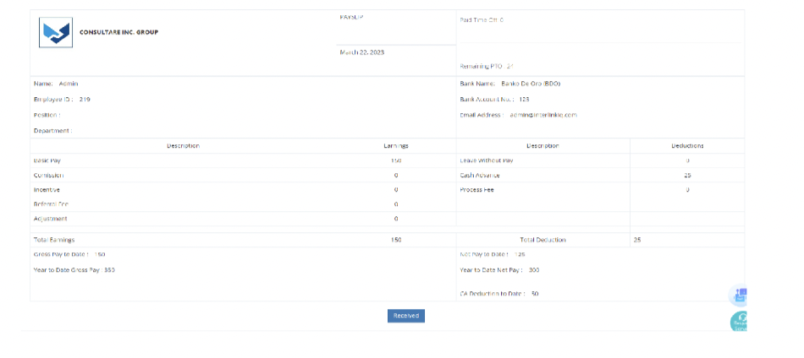
  PAYROLL
Salaries will be put ON HOLD:
If service logs is not updated within one cut-off period. Service logs should be updated daily. The admin manager will check the service logs regularly.
If Payslip of the previous cut-off is not received.
On-hold pay will be processed late 3 to 5 days after pay schedule and will received an Incident report for non-compliance.

Slide 35
  DEDUCTIONS
Absences
Company Loans
Cash Advances
Asset requisition
Remittance transaction fees.

Slide 36
  Definition of Terms
Incident Report – a document issued reporting the events, documenting the facts related to the incident in the workplace.

Slide 37
  Definition of Terms
Notice to Explain - is a document issued to any Virtual Assistant who violated the company policy, rules, and procedures. An incident that violated the company policy rules and procedures.

Slide 38
  Issuance of NTE 1
An NTE 1 will be issued to a Virtual Assistant with a supporting incident report and factual evidence.
The Virtual Assistant will be given 24 hours to explain and to present her factual evidence to prove otherwise the NTE issued.

Slide 39
  Issuance of NTE 1
b.) Once the response is received and proof of violation is presented, the Virtual Assistant is forfeited to receive any tenureship, bonuses, and incentives within six (6) months.
c.) The Virtual Assistant will undergo a re-training and Evaluation for 15 days and be called for counseling by HR.

Slide 40
  Issuance of NTE 2
An NTE 2 will be issued to Virtual assistant after the issuance of NTE 1 within one (1) year calendar period.
The Virtual Assistant will be given 24 hours to explain and to present her factual evidence to prove otherwise the NTE issued.

Slide 41
  Issuance of NTE 2
b) Once the response is received and proof of violation is presented, the Virtual Assistant is forfeited to receive any tenure ship, promotion, bonuses and incentives within one (1) year.
c) The Virtual Assistant will undergo a re-training and Evaluation for 15 days and be called for counseling by HR.

Slide 42
  Issuance of NTE 3
An NTE 3 will be issued to Virtual assistant after issuance of NTE within one (1) fiscal year period.
The Virtual Assistant will be given 24 hours to explain and to present her factual evidence to prove otherwise the NTE issued.

Slide 43
  Issuance of NTE 3
b) Once a response is received and proof of violation is presented, the Virtual Assistant is terminated to all his company access and will be issued a Notice of Termination.

Slide 44
A Virtual Assistant who has been issued an NTE 1, NTE 2, and NTE 3 will reset every fiscal year.
An NTE will be cleared within one (1) year from issuing the last NTE date.
Example:
NTE 1 - issued January 5, 2022
NTE 2 – issued December 26, 2022
Clearance – December 27, 2023

Slide 45
  NTE 1 Clearance
After issuance of NTE, a 15 days evaluation based on action item and recommendation.
After three (3) months of evaluations and observations, NTE can be lifted based on manager recommendation and top management approval.

Slide 46
 | 1st Offence | 2nd Offence | 3rd Offence | 4th Offence | 5th Offence
Verbal Warning from Immediate Head
Written Warning from HR personnel with IR
Written Warning with IR and NTE 1
Written Warning with IR and NTE 2
NTE 3 – Notice of Termination

Slide 47
  ABANDONMENT
Abandonment of duties and responsibilities within 48 hours will automatically be terminated and tagged as AWOL – absence without leave.
An AWOL Virtual Assistant will not receive the final pay and Certificate of Employment.

Slide 48
CONSULTARE INC. GROUP
A Compliance Co.
Established 2013

